Slide 1
Trajectory Filtering & Object Detection
Instruction
kevin8299

Slide 2
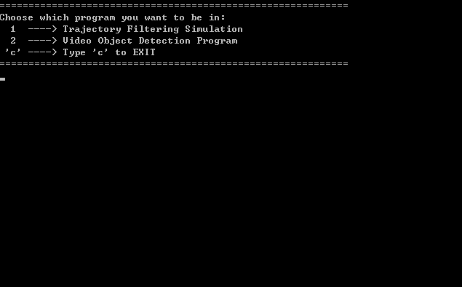
Start Up Menu

Slide 3
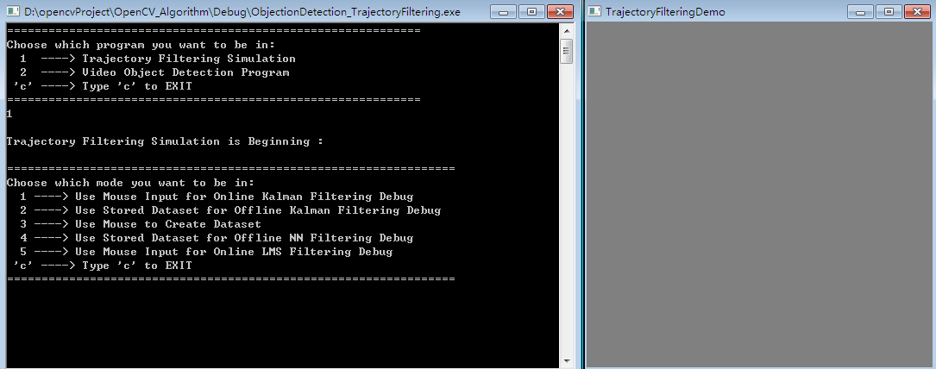
Type '1' and then enter the Trajectory Filtering Mode
When choose to set into Trajectory Filtering, a TrajectoryFilteringDemo window would show, so the screen focus is now in this window, you need to click the cmd window to drag the focus back, sorry for this awkward interaction process.

Slide 4
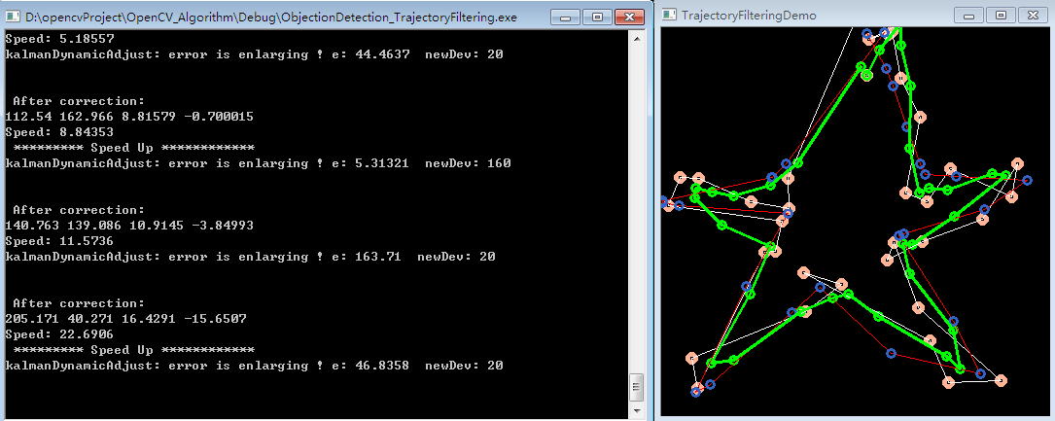
Type '1' and then enter to be in Realtime Filtering Mode with Speed Adaptive Kalman Filter
read line is original trajectory without noise
white line is noised trajectory
green line is the filtered trajectory

Slide 5
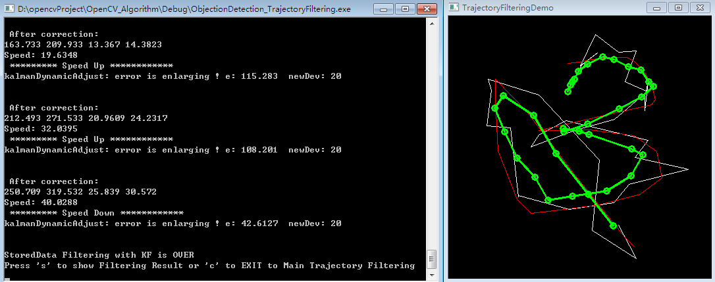
Type '2' and then enter to be in Realtime Filtering Mode of Stored dataset with Speed Adaptive Kalman Filter

Slide 6
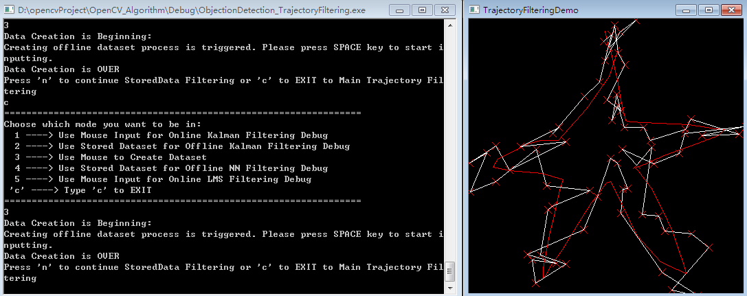
Type '3' and then enter to be in dataset creation mode. You need to move mouse on the TrajectoryFilteringDemo window, and click it to set focus on it and then tap SPACE key to start trajectory input, and again SPACE to stop input.
read line is original trajectory without noise
white line is noised trajectory

Slide 7
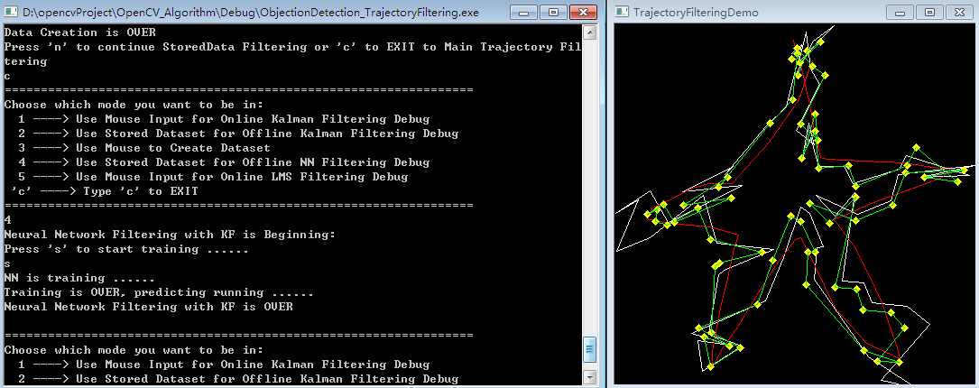
Type '4' and then enter to be in Offline Filtering Mode of Stored dataset with Neural Network Modelling
read line is original trajectory without noise
white line is noised trajectory
thin green line is the filtered trajectory

Slide 8
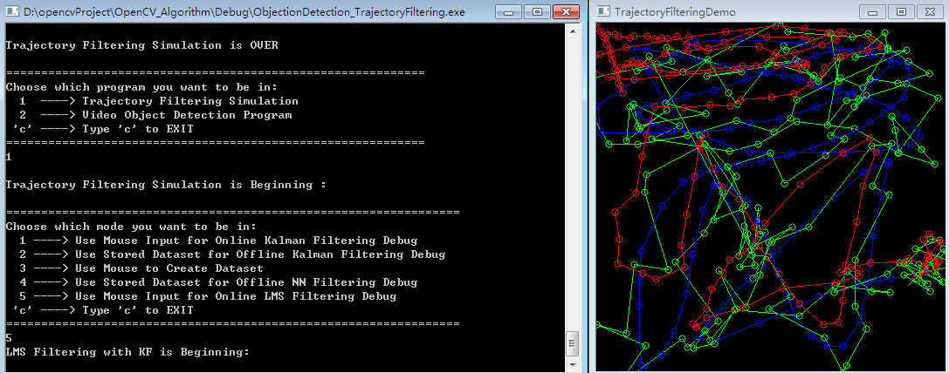
Type '5' and then enter to be in Realtime Filtering Mode with LMS filter
Read line is the filtered trajectory
Green line is noised trajectory
Blue line is the filtered trajectory
(You can see that the LMS filtering is very good when it learns for some time, which means at beginning the filtering result is NOT tolerable.)

Slide 9
When Back to the Start Menu Type '2' and then enter to be in Object Detection Mode

Slide 10
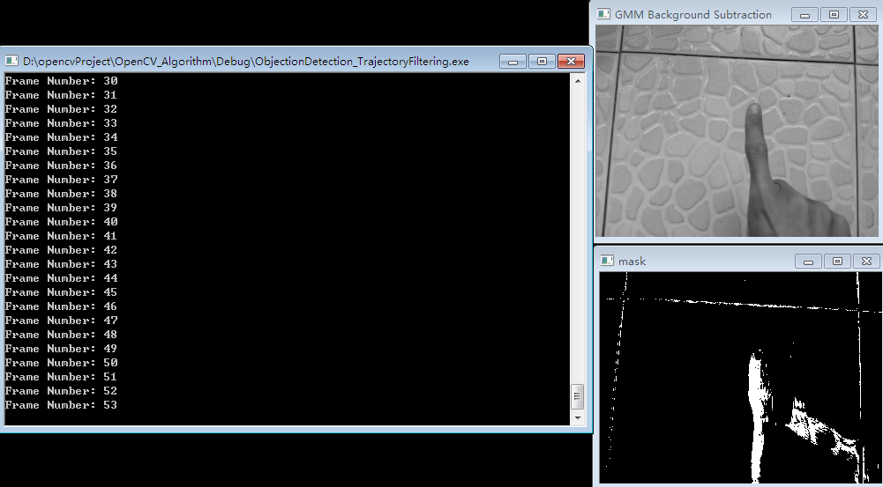
Type '1' and then enter to be in GMM Background Subtraction Mode
GMM Background Subtraction window is the original gray image, mark window is the detected object window

Slide 11
Type '2' and then enter to be in mixture algorithm of color analysis & feature extraction
Color Discrimination window is the result of color discrimination
Binary Image to Detect Hands window is the found hands surrounded by green line
The smallest window is the detected finger marked by a white rectangle, where feature matcher only search the rectangle containing the found hand in Binary Image to Detect Hands window.
(Now the feature matcher is based on LBP features, and the effect is NOT fine, so I will make more robust features in next improvement.)

